Slide 1

Episkop
Manuel Trevino
Nicolas Benavides Levin
Cole Newby
Kavi Thiagarajan

Slide 2
Problems to Solve
Popular poll applications:
Google Forms
StrawPoll
General Issues:
Poll formats are relatively similar
Classical test questions are overused with little innovation
1
3
2
Segmented survey process:
4
The Question:
How can we create a more fluid online polling system and improve upon what’s stagnant?
Poll Creation
Data Collection
Data Analysis
Ex: CSCE 315 in class surveys

Slide 3


The Episkop Solution
Poll Creation
Data Collection
Data Analysis
Goals:
Bring these phases closer together
Improve the good parts of modern survey systems
Episkop:
Constructs and shares polls that are modifiable at any time.
Dynamically refreshes data in front of the user.
Beautifully displays of data in a variety of graphical formats.
More question types
Cleaner look & feel
Increased social aspect

Slide 4
User Experience: Major Components
Creating Polls
Responding
API Administration
Sharing Polls
Revisiting Polls
API Requests
Spectating Responses
Organizing Polls
Downloading Data
Displaying Data
Analyzing Data

Slide 5


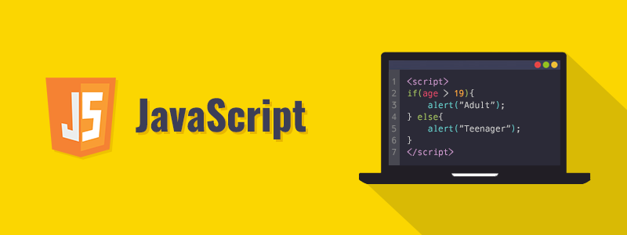
Design
Front-end and Javascript
Database
Back-end
01
03
We utilized AJAX and partial renders to add elements onto the DOM. This helped us create a clean, single page experience.
02
We utilized an Amazon EC2 instance to store our data and operate on our codebase. PostgreSQL was our method of data storage and maintenance.
We constructed CRUD objects for each of our major object types: polls, poll questions, poll answers, users, and api keys.

Slide 6
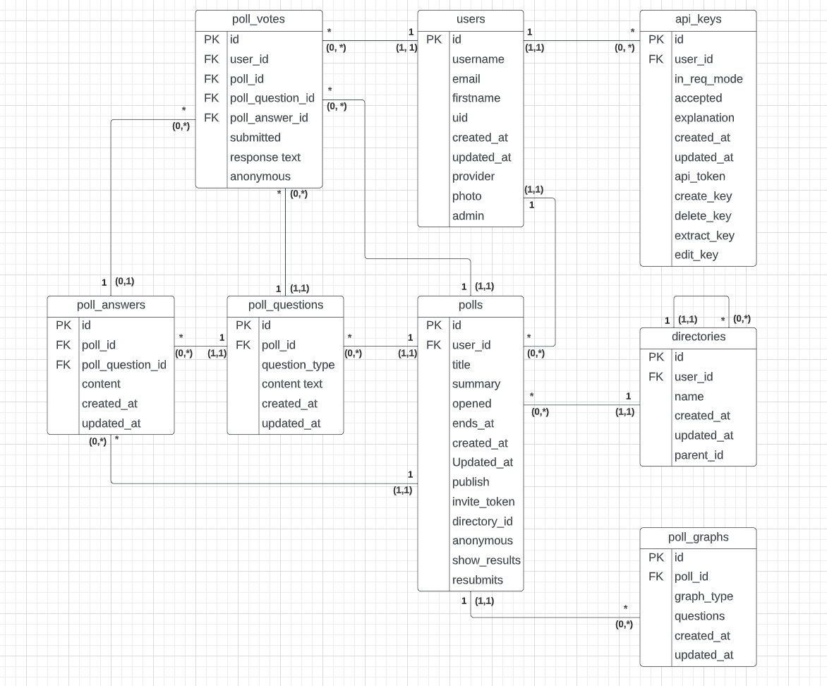
Postgres Database Design
The modularity of our database design allows for the easy addition of new question types and graphs, making it simple for new developers to expand Episkop!

Slide 7


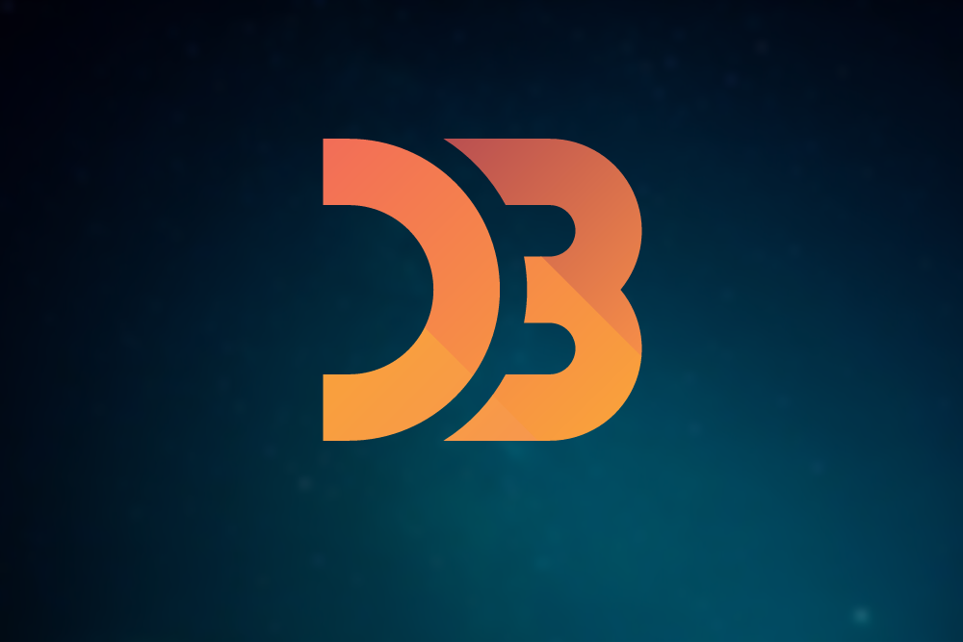
The Front-end and Javascript
Episkop utilizes bootstrap 5 as main front-end css framework. Bootstrap allows for easy structuring and styling of HTML elements.
Episkop is a javascript heavy application, using jquery and .js requests to the server in order to seamlessly insert html into the DOM
Episkop also uses the D3 javascript library to create the graphs used to display poll data

Slide 8
Project Challenges

Slide 9
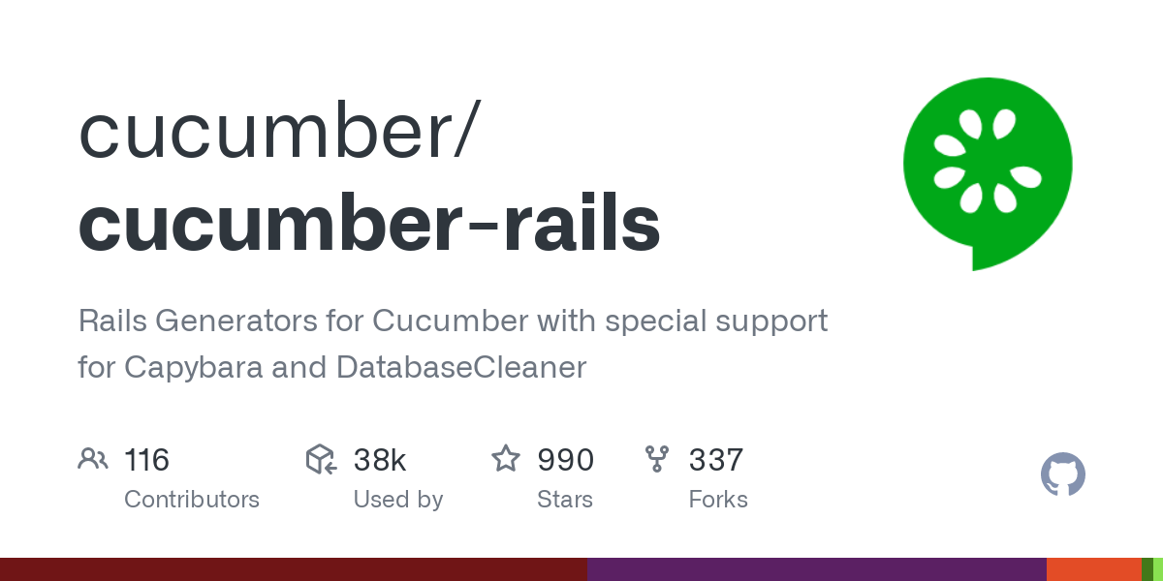
Cucumber-Rails
01
When attempting to write testing for our project, we ran into a host of compatibility issues regarding Cucumber-Rails.
We discovered that Cucumber-Rails does not support the version of Rails used for our project: Rails 7.0.1.
Since we had already programmed a significant portion of our project using Rails 7.0.1, we opted to scrap the use of Cucumber-Rails with the approval of Dr. Ritchey.
Instead using rspec features tests, alongside capybara, to implement behavior driven testing

Slide 10

Debugging
02
As we developed our project further, we found that debugging became more and more difficult.
Much of this was due to nested queries due to database normalization and the large amount of view forms and files we had to sift through.
However, once we cleaned up our codebase, refactored files, and removed unnecessary files, the debugging process became much easier.

Slide 11

Reformatting Structure
03
Initially, we used the default configuration of rails for our application, however we later realized that this would not be suitable for the features that we desired. Instead, we decided to reconfigure our codebase to use Esbuild, an extremely fast javascript bundler, instead of importmaps.
Furthermore, early on in the project, we reformatted our database structure as shown in the Postgres Database Design slide to meet the requirements for our application.

Slide 12


CSS with Deployment
04
The least of our concerns, some of our icons would not load after deploying our codebase to heroku. We decided to ignore this, as the majority of our app does not utilize icons.
On the contrary, we did find it necessary to finalize our CSS midway through the development process, as the organization of the poll creation and response page relied heavily on the look of the site.

Slide 13
Lessons Learned

Slide 14
Versioning
01
Versioning is a difficult but necessary aspect of web development.
While we struggled in the beginning with rails compatibility issues, we learned that solidifying your versioning early on is essential for future success.
This includes researching what tools you will need and what corresponding versions of software your team should use.
Again!

Slide 15

Git Branches
02
As we implemented more features in our development, we found that the use of Git branches were incredibly useful in maintaining the stability of the application.
For instance, we dedicated a new branch to every major feature we implemented, allowing us to debug and test this feature before merging it with the main branch.

Slide 16

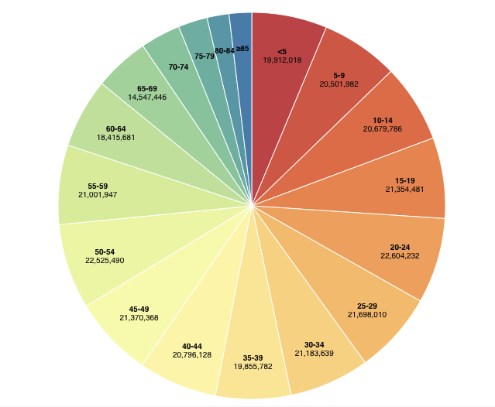
Integration of Different Components and Libraries
03
One of the most difficult challenges to overcome was the integration of different frameworks, libraries, and our own code.
At the start, a lot of time was spent in trying to get the codebase to work with the bootstrap framework and font-awesome icons.
The biggest obstacle was how to integrate the D3 library into the project. The problem was trying to figure out a way of having Javascript script code, separate from the server controller, synchronously modify the html view in order to insert the graphs and give the user a seamless experience

Slide 17

Ajax
04
Constructing a single-screen experience was one of the most time consuming aspects of our development process.
Utilizing ajax required a lot of research into use cases. Given the specificity of our goals, finding related sources was tedious at some points.
Debugging was not as troublesome, as we could analyze what was being rendered via the command line and DOM inspection; however, many of our bugs consisted of issues caused by one or two character differences (ex: @, {}, [], etc.).

Slide 18
Future Tasks:
API Voting
User Grouping
Email Lists
Poll Tags
Dynamic Addition of Respondent Answer Choices
Dark Mode

Slide 19
Thank you.

